Slide 1
Registers

Slide 2
Registers
Flip flops can store a single bit of binary data i.e. 1 or 0. But if we need to store multiple bits of data, we need multiple flip flops. As a single flip flop is used for one bit storage, n flip flops are connected in an order to store n bits of data.
In digital electronics, a Register is a device which is used to store the information. Flip flops are used in constructing registers.
Register is a group of flip flops used to store multiple bits of data. For example, if a computer is to store 16 bit data, then it needs a set of 16 flip flops. The input and outputs of a register are may be serial or parallel based on the requirement.

Slide 3
Shift Register
This sequential device loads the data present on its inputs and then moves or “shifts” it to its output once every clock cycle, hence the name “shift register”.

Slide 4
Applications of Shift Registers
Registers are used in digital electronic devices like computers as
Temporary data storage
Data transfer
Data manipulation
As counters.
Shift registers are used in computers as memory elements. All the digital systems need to store large amount of data, in an efficient manner; there we use storage elements like RAM and other type of registers.
Many of the digital system operations like division, multiplication are performed by using registers. The data is transferred through serial shift registers and other type.
Counters are used as Digital clocks, Frequency counters, Binary counters etc.

Slide 5
shift register
A shift register is a sequential circuit which stores the data and shifts it towards the output on every clock cycle.
Basically shift registers are of 4 types. They are
Serial In parallel Out shift register
Serial In Serial Out shift register
Parallel In Serial Out shift register
Parallel In parallel Out shift register

Slide 6
Serial-in Parallel-out (SIPO) Shift Register
4-bit Serial-in to Parallel-out Shift Register
The operation is as follows. Lets assume that all the flip-flops ( FFA to FFD ) have just been RESET ( CLEAR input ) and that all the outputs Q_{A} to Q_{D} are at logic level “0” ie, no parallel data output.
If a logic “1” is connected to the DATA input pin of FFA then on the first clock pulse the output of FFA and therefore the resulting Q_{A} will be set HIGH to logic “1” with all the other outputs still remaining LOW at logic “0”.
The second clock pulse will change the output of FFA to logic “0” and the output of FFB and Q_{B} HIGH to logic “1” as its input D has the logic “1” level on it from Q_{A}. The logic “1” has now moved or been “shifted” one place along the register to the right as it is now atQ_{A}.

Slide 7
When the third clock pulse arrives this logic “1” value moves to the output of FFC ( Q_{C} ) and so on until the arrival of the fifth clock pulse which sets all the outputs Q_{A} to Q_{D} back again to logic level “0” because the input to FFA has remained constant at logic level “0”.
The effect of each clock pulse is to shift the data contents of each stage one place to the right, and this is shown in the following table until the complete data value of 0-0-0-1 is stored in the register. This data value can now be read directly from the outputs of Q_{A} to Q_{D}.

Slide 8
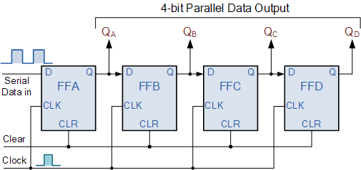
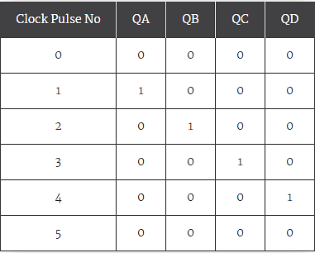
Block diagram of a 4-bit Serial-in to Parallel-out Shift Register
Basic Data Movement Through A Shift Register

Slide 9
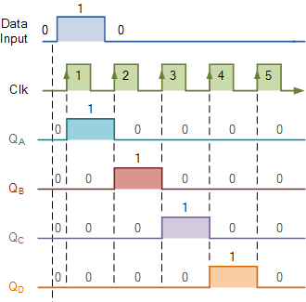
Timing diagram

Slide 10
Serial in Serial Out Shift Register
This shift register is very similar to the SIPO above, except were before the data was read directly in a parallel form from the outputs Q_{A} to Q_{D}, this time the data is allowed to flow straight through the register and out of the other end. Since there is only one output, the DATA leaves the shift register one bit at a time in a serial pattern, hence the name Serial-in to Serial-Out Shift Register or SISO.
The SISO shift register is one of the simplest of the four configurations as it has only three connections, the serial input (SI) which determines what enters the left hand flip-flop, the serial output (SO) which is taken from the output of the right hand flip-flop and the sequencing clock signal (Clk). The logic circuit diagram below shows a generalized serial-in serial-out shift register.

Slide 11
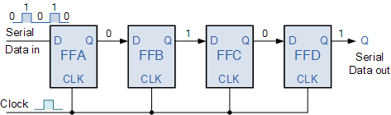
4-bit Serial-in Serial-out Shift Register
You may think what’s the point of a SISO shift register if the output data is exactly the same as the input data.
Well this type of Shift Register also acts as a temporary storage device or it can act as a time delay device for the data, with the amount of time delay being controlled by the number of stages in the register, 4, 8, 16 etc or by varying the application of the clock pulses.

Slide 12
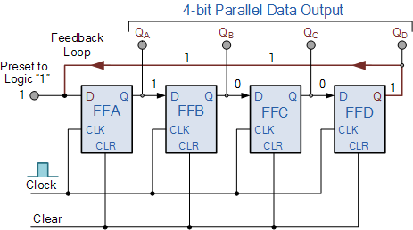
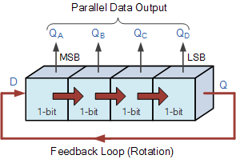
Ring counter
By looping the output back to the input, (feedback) we can convert a standard shift register circuit into a ring counter. Consider the circuit below.
Rotational Movement of a Ring Counter
Figure: Block diagram of a ring counter

Slide 13
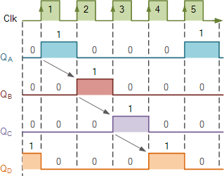
Since the ring counter example shown above has four distinct states, it is also known as a “modulo-4” or “mod-4” counter.
The “MODULO” or “MODULUS” of a counter is the number of states the counter counts or sequences through before repeating itself.
For example, a mod-8 ring counter requires eight flip-flops and a mod-16 ring counter would require sixteen flip-flops.
Drawback:
However, as in our example above, only four of the possible sixteen states are used, making ring counters very inefficient in terms of their output state usage.

Slide 14
Johnson Ring Counter
The Johnson Ring Counter or “Twisted Ring Counters”, is another shift register with feedback exactly the same as the standard Ring Counter above, except that this time the inverted output Q of the last flip-flop is now connected back to the input D of the first flip-flop as shown below.
a “n-stage” Johnson counter will circulate a single data bit giving sequence of 2n different states and can therefore be considered as a “mod-2n counter”.

Slide 15
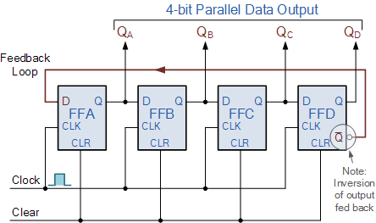

Slide 16
This inversion of Q before it is fed back to input D causes the counter to “count” in a different way. Instead of counting through a fixed set of patterns like the normal ring counter such as for a 4-bit counter, “0001”(1), “0010”(2), “0100”(4), “1000”(8) and repeat, the Johnson counter counts up and then down as the initial logic “1” passes through it to the right replacing the preceding logic “0”.
A 4-bit Johnson ring counter passes blocks of four logic “0” and then four logic “1” thereby producing an 8-bit pattern. As the inverted output Q is connected to the input Dthis 8-bit pattern continually repeats. For example, “1000”, “1100”, “1110”, “1111”, “0111”, “0011”, “0001”, “0000” and this is demonstrated in the following table below.

Slide 17
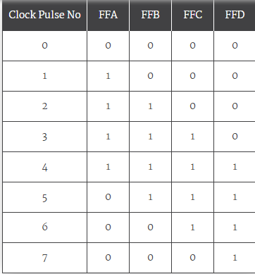
Truth Table for a 4-bit Johnson Ring Counter

